Slide 1

K.L.E SOCIETY'S
CHIDANAND. B. KORE POLYTECHNIC, CHIKODI
KARNATAKA 2022-23
DEPARTMENT OF COMPUTER SCIENCE & ENGINEERING
A Presentation On
"HOTEL MANAGEMENT SYSTEM"
Submitted By:-
Aishwarya Patil 339CS20003
Pranay Hiremath 339CS20017
Shruti Gurav 339CS20026
Vaidehi Deval 339CS20033

Slide 2
Introduction
The HOTEL MANAGEMENT SYSTEM is a hotel reservation site script where user will be able to search room availability with an online booking reservation system. Site user can also browse hotel, view room inventory, check availability, and book reservation in real-time. Site user enter check in date and check out date then search for availability and rate. After choosing the right room in the wanted hotel all booking and reservation process is done through online.

Slide 3
Abstract
The purpose of this project “Hotel Management System” involves maintaining various operations like user can check the room availability and also book the room online and hotel admin can login to this system and view the room booking list and cancellation of the room, cash billing and room service. We are going to develop this project using this modules like user module in this view room, check room availability and book room. In admin module admin login, view room booking, manage rooms etc. To implement this project we will use full stack languages like HTML, CSS, JavaScript, Bootstrap, PHP, MySQL database etc.

Slide 4
Literature survey
Existing System :-
As per the my market survey there is no such type of system are available. In some hotel online room booking facilities are not available. And in some hotel online room booking facilities are available. So for the user we are going to develop this project by this user can book the room by call and visit the room. By this user can save the time.
Proposed System :-
We are going to develop the hotel management system. The purpose of this project “Hotel Management System” involves maintaining various operations like user can check the room availability and also book the room online and hotel admin can login to this system and view the room booking list and cancellation of the room, cash billing and room service. We are going to develop this project using this modules like user module in this view room, check room availability and book room. In admin module admin login, view room booking, manage rooms etc. To implement this project we will use full stack languages like HTML, CSS, JavaScript, Bootstrap, PHP, MySQL database etc.

Slide 5
Requirements
Requirements for developing:-
Average I3 processor.
Average 4GB RAM.
Average 512GB hard disk.
Hardware requirement for deployment:-
average I3 processor.
Average 2GB RAM.
Average 256GB storage.
Software requirement for development:-
OS (Window’s , MAC , Linux).
XAMP Server.
VS Code.
Chrome.
Software requirement for deployment:-
OS.
Chrome.
Language used or technology:-
Content language (client side language)
( HTML, CSS, bootstrap, JS).
Backend (server side language) (PHP).
Database (MySQL).

Slide 6
Advantages
User can book the room from any location.
Reduce the time.
Reduce manual work.
Can connect with the user easily.
Increase your online visibility.

Slide 7
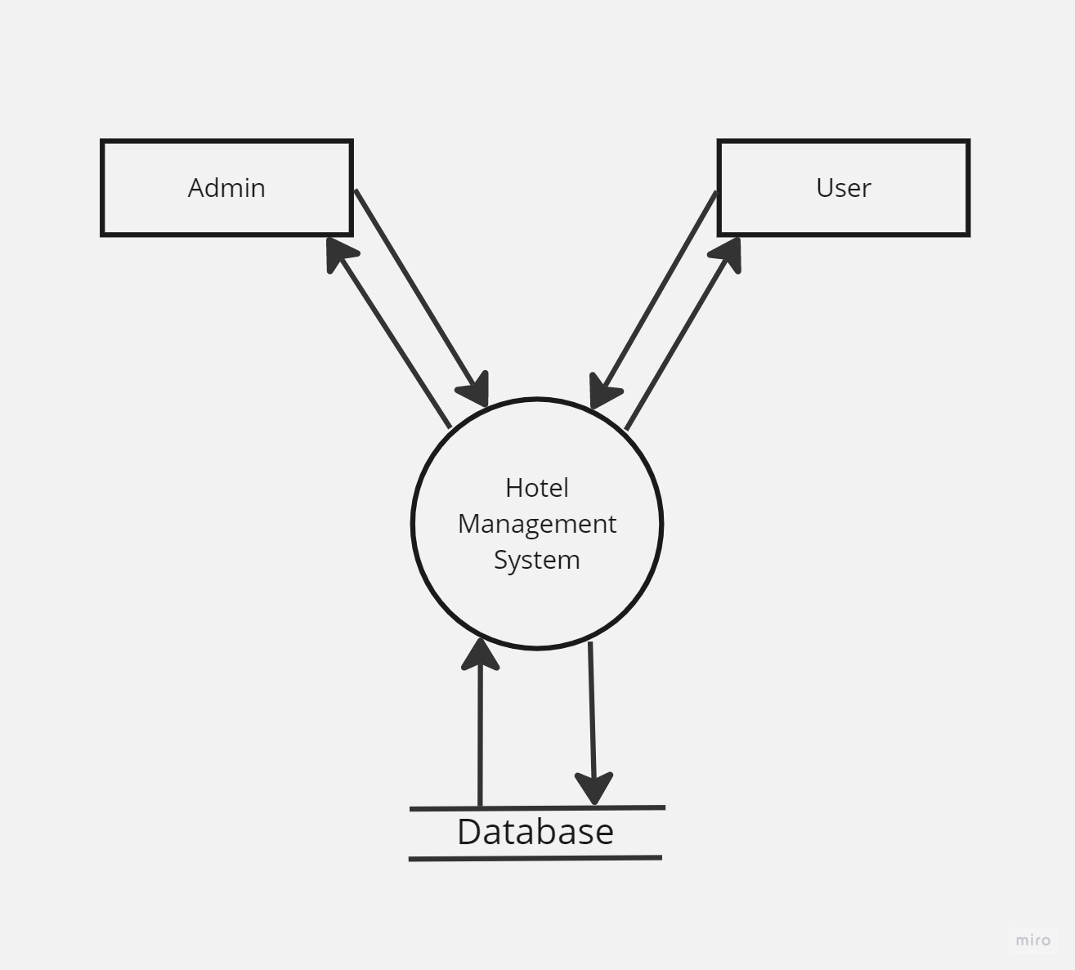
Data Flow Diagram Level-0

Slide 8
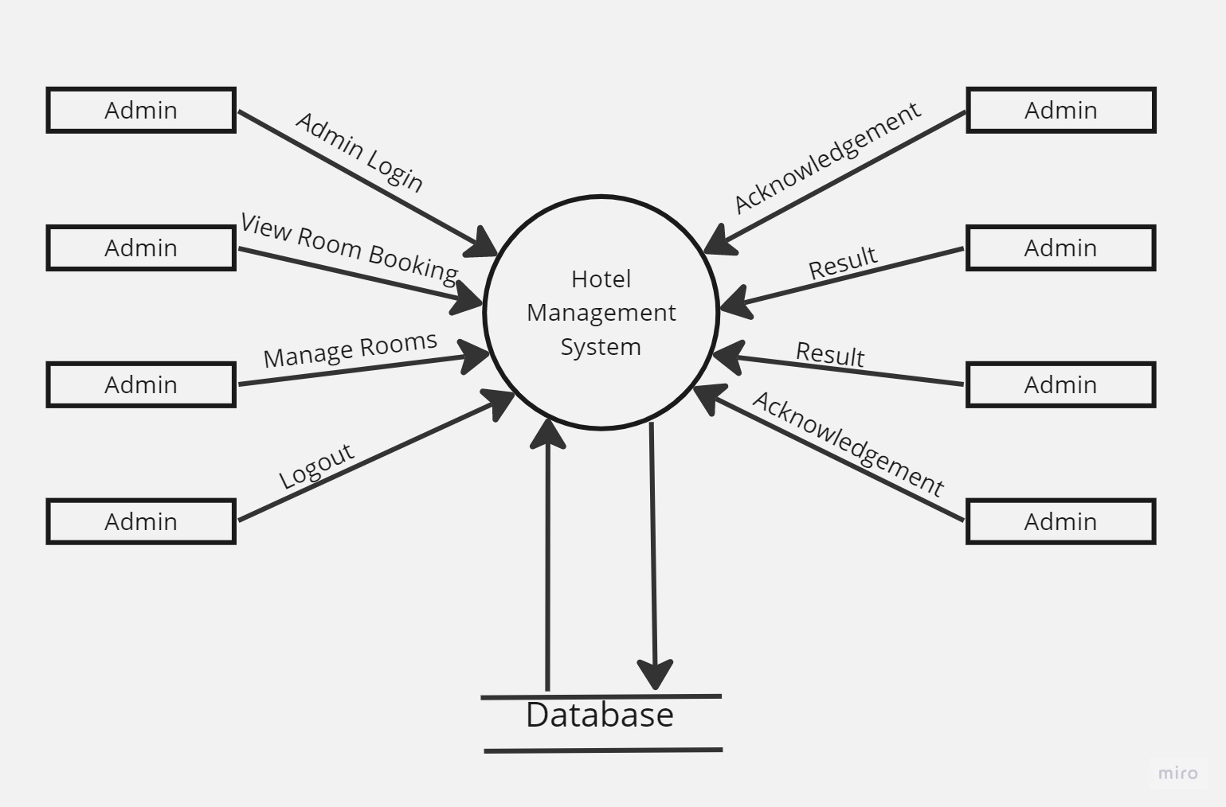
Data Flow Diagram Level-1

Slide 9
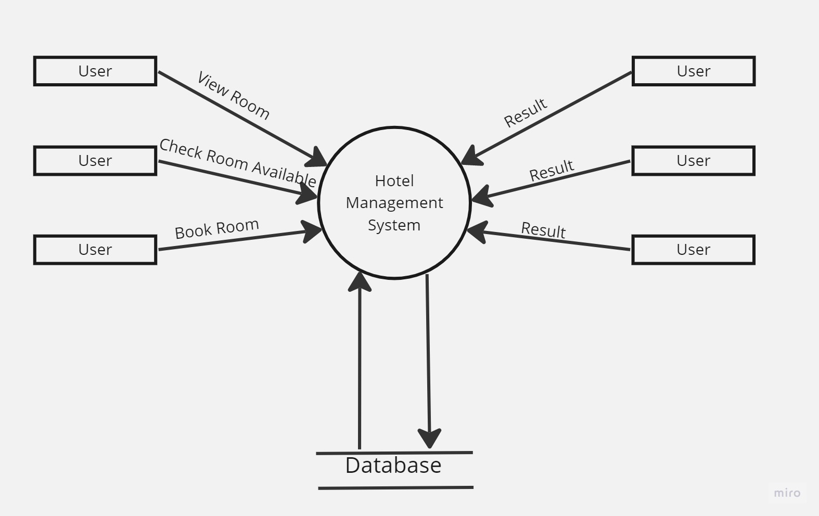
Data Flow Diagram Level-1

Slide 10
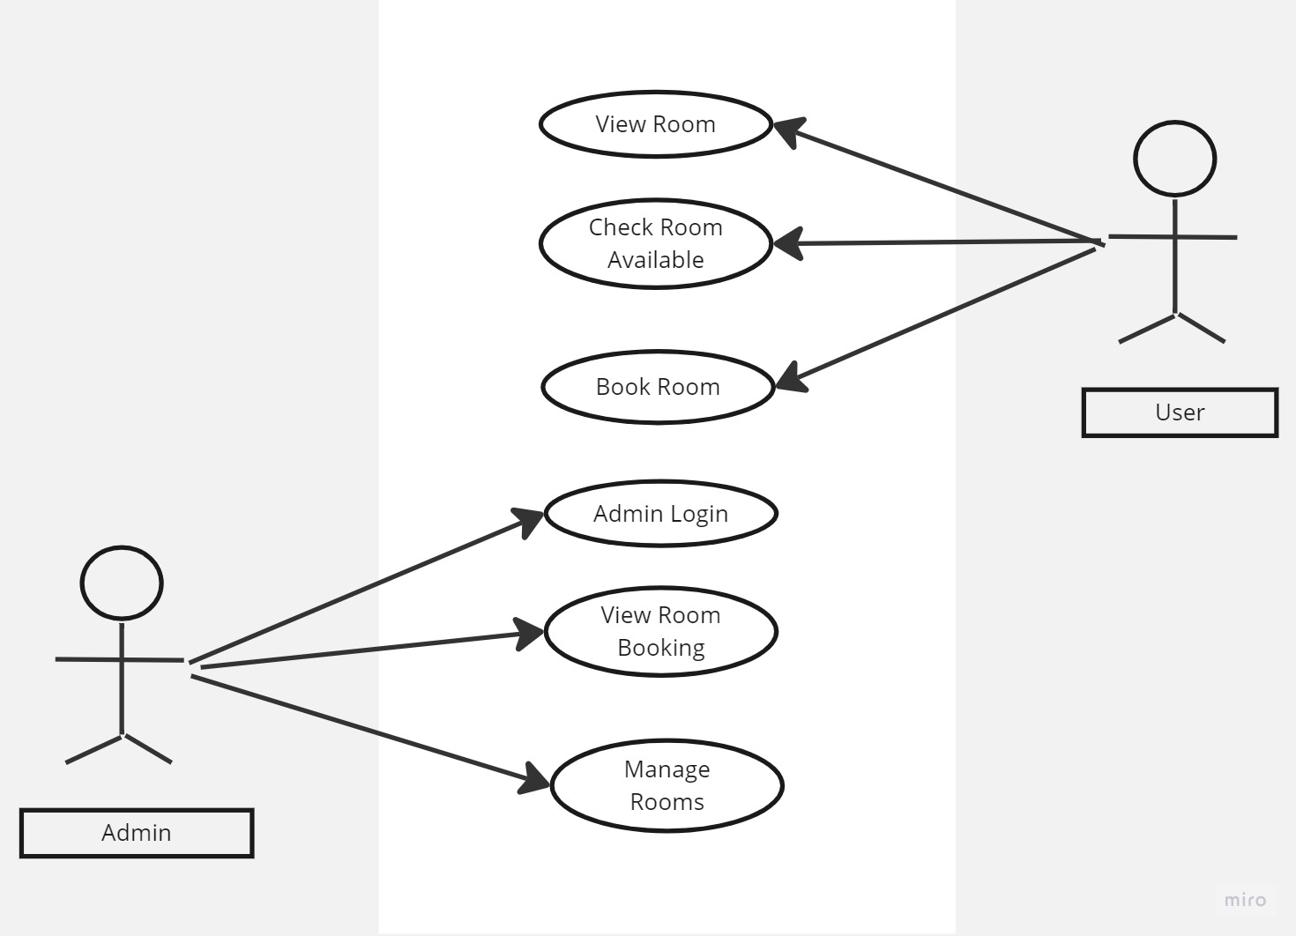
Use-Case Diagram

Slide 11
Methodologies Used
Methodologies Used Agile methodology is a process for managing a project that involves constant collaboration and working in iterations. Agile project management works off the basis that a project can be continuously improved upon throughout its life cycle, with changes being made quickly and responsively. Agile is one of the most popular approach to project Management due to it's flexible, adaptability to change, and high level of customer input.
Phases of Agile model
Requirement Gathering
Design the requirements
Construction or Iterations
Testing and Quality assurance
Deployment
Feedback

Slide 12
Implementation Part
Here we are using two main modules to implement our project, in that there are three sub modules in each main module they are :-
Admin Module
Admin Login
View Room Booking
Manage Room
User Module
View Room
Check Room Available
Book Room

Slide 13
Future Scope
In future we will implement this project to live to an to any hotel.
We will develop the mobile application.

Slide 14
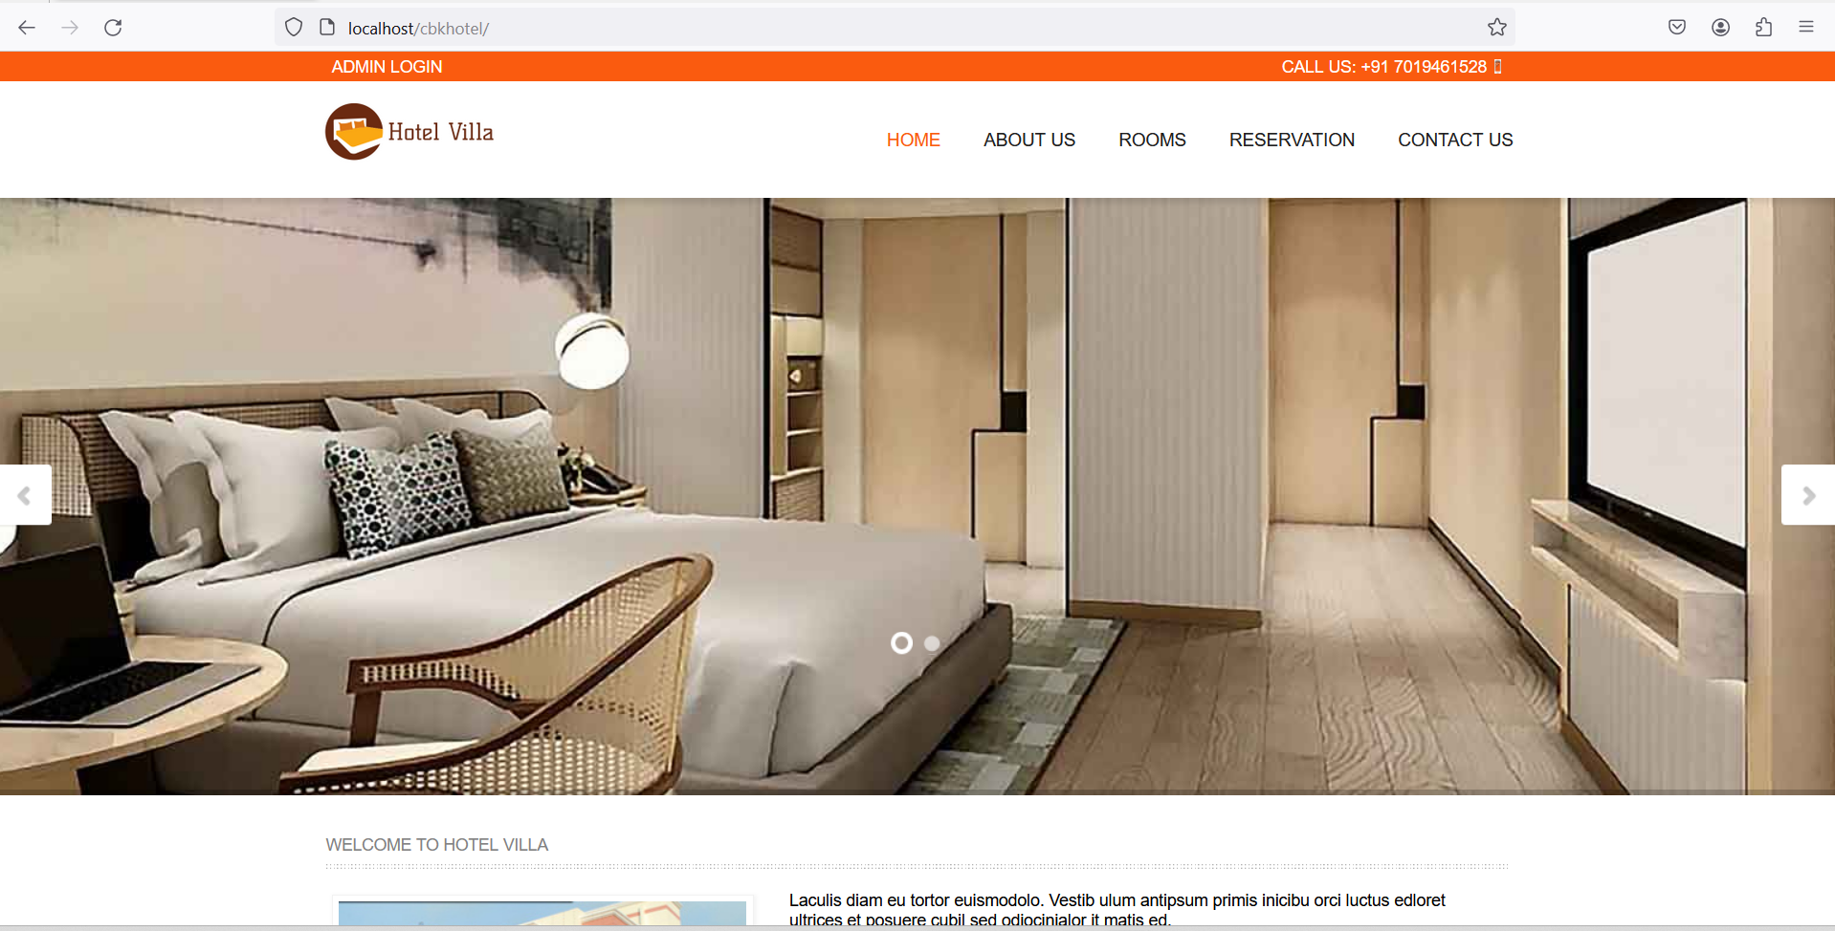
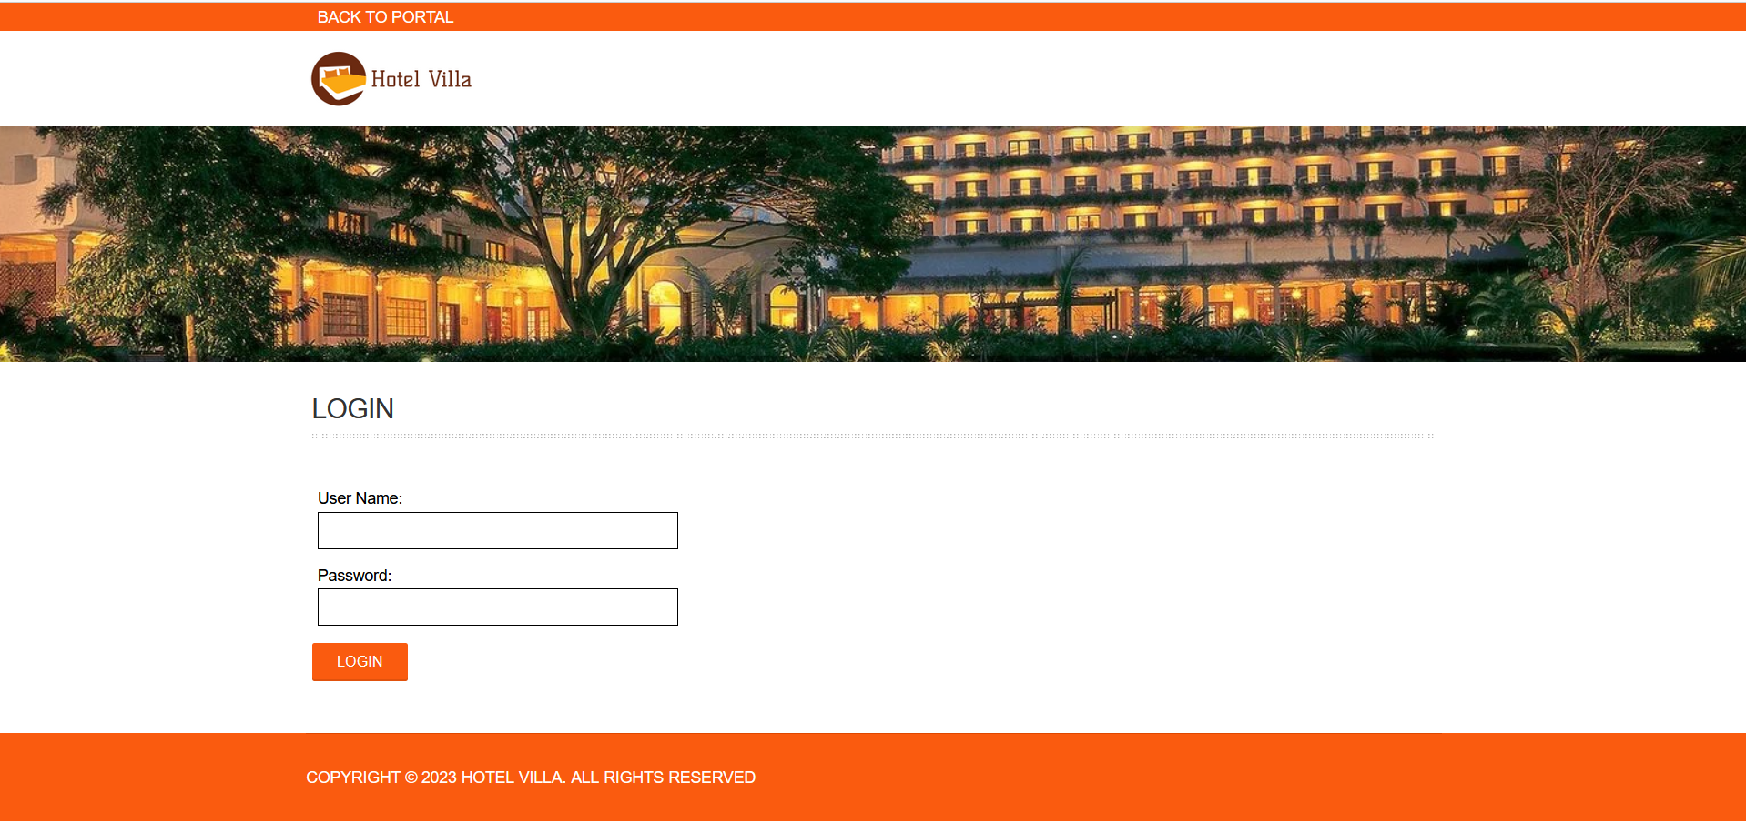
Screen Shorts And Designed Websites

Slide 15
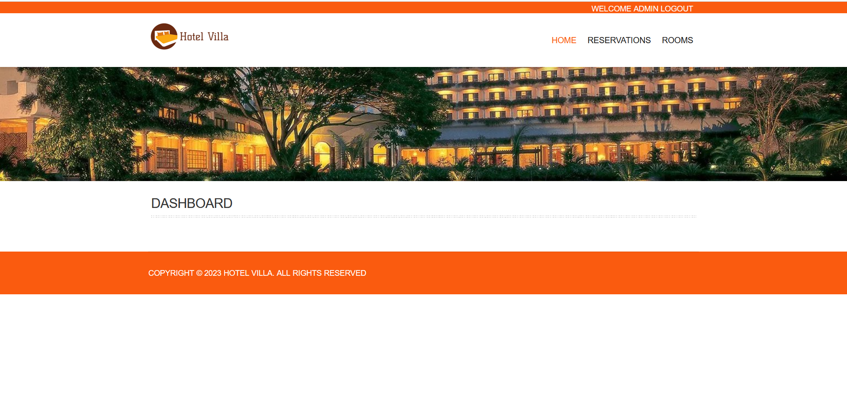
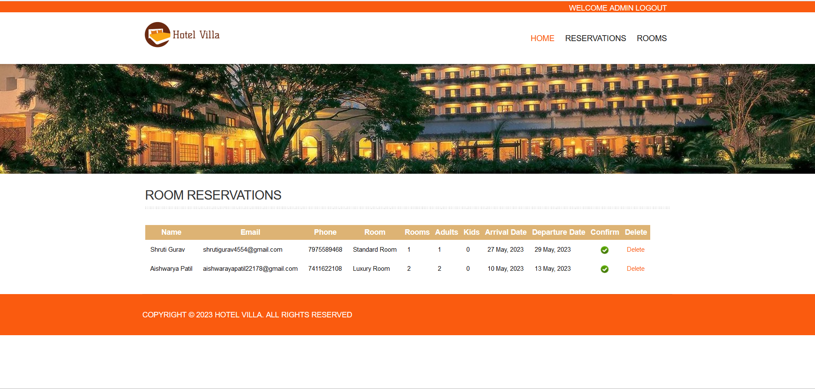

Slide 16
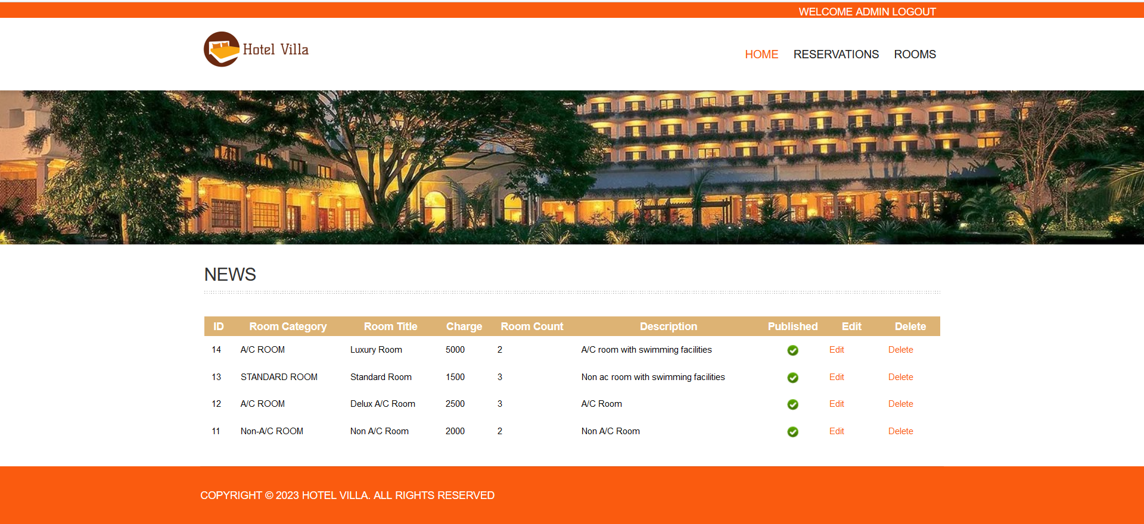
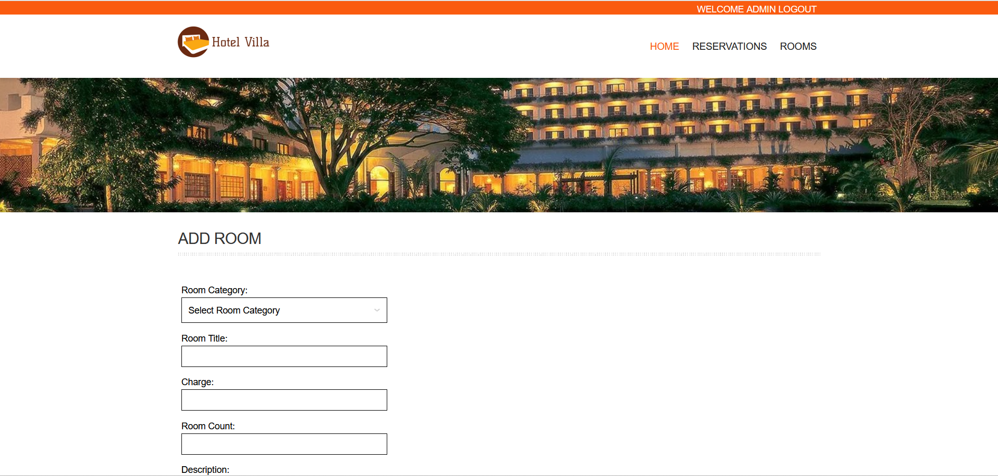

Slide 17
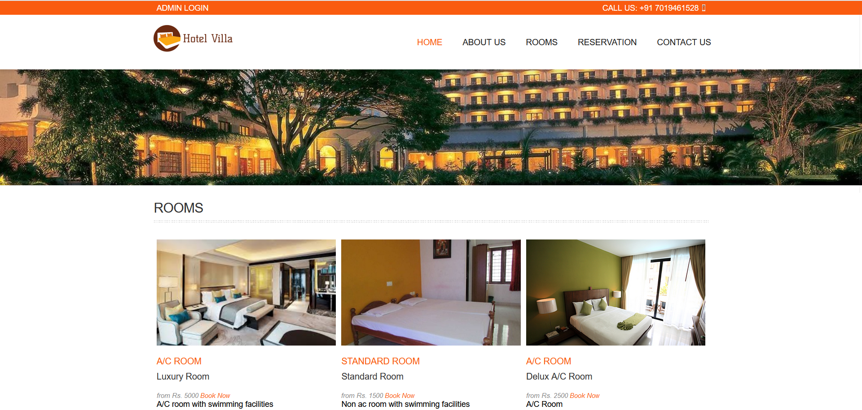
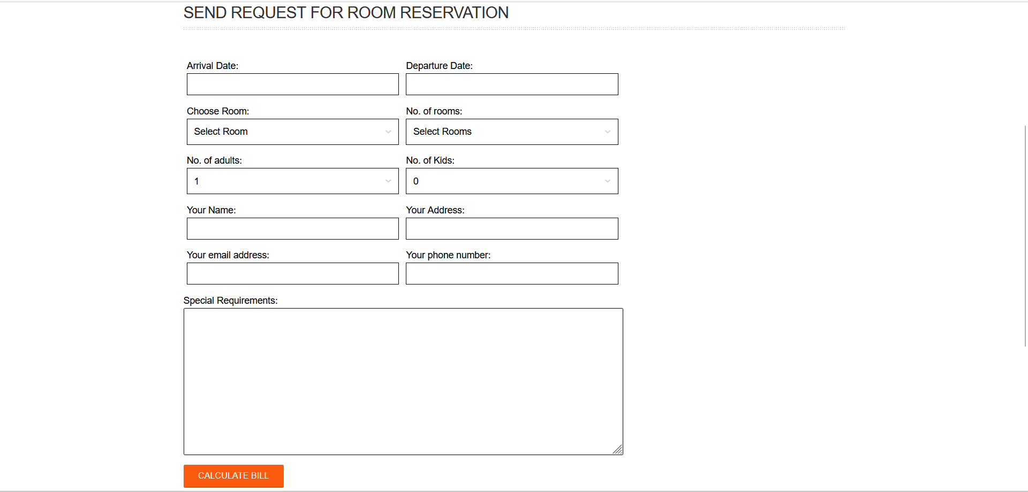

Slide 18
Conclusion
As per the synopsis we will implement “Hotel Management System” with all the modules like user module in this view room, check room availability and book room. In admin module admin login, view room booking, manage rooms etc. All modules name we will implement our project error free and user friendly.

Slide 19
BIBLIOGRAPHY
Books:-
[1] “Web Programming”, by ‘Chris Bates’ Wiley Dream tech India, 2nd Edition.
[2] “Software Engineering”, Ian Somerville, Sixth Edition, Pearson Education Ltd.
[3] “HTML Complete References” Easy steps to develop web pages.
[4] “PHP Complete Reference”
Websites:-
[1] http://en.wikipedia.org/wiki/PHP for PHP.
[2] http://www.hotscripts.com/category/php/ for PHP.
[3] http://www.mysql.com/click.php?e=35050 for MYSQL.
[4] http://www.w3schools.com for information on HTML.

